Slide 1


2023 NEAF Training Course
Digital Image Process
Date: 2023/7/28
Instructor: Cheng-Kai Wu

Slide 2
Outline
Image Basics
Widely Used DIP Methods
Histogram Equalization
Blur: mean blur, median blur, gaussian blur
Binary
HSV filter
Morphological: erosion, dilation, open, close
Find contours

Slide 3
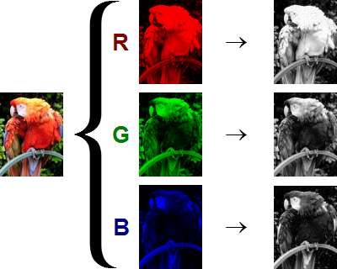
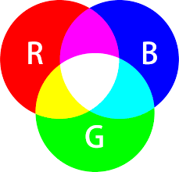
Image Basics

Slide 4
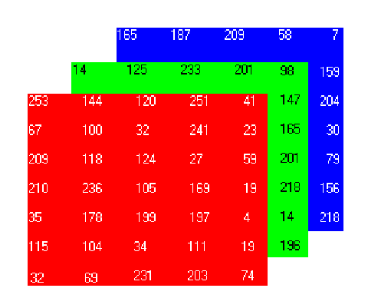
Image Basics
0
255

Slide 5
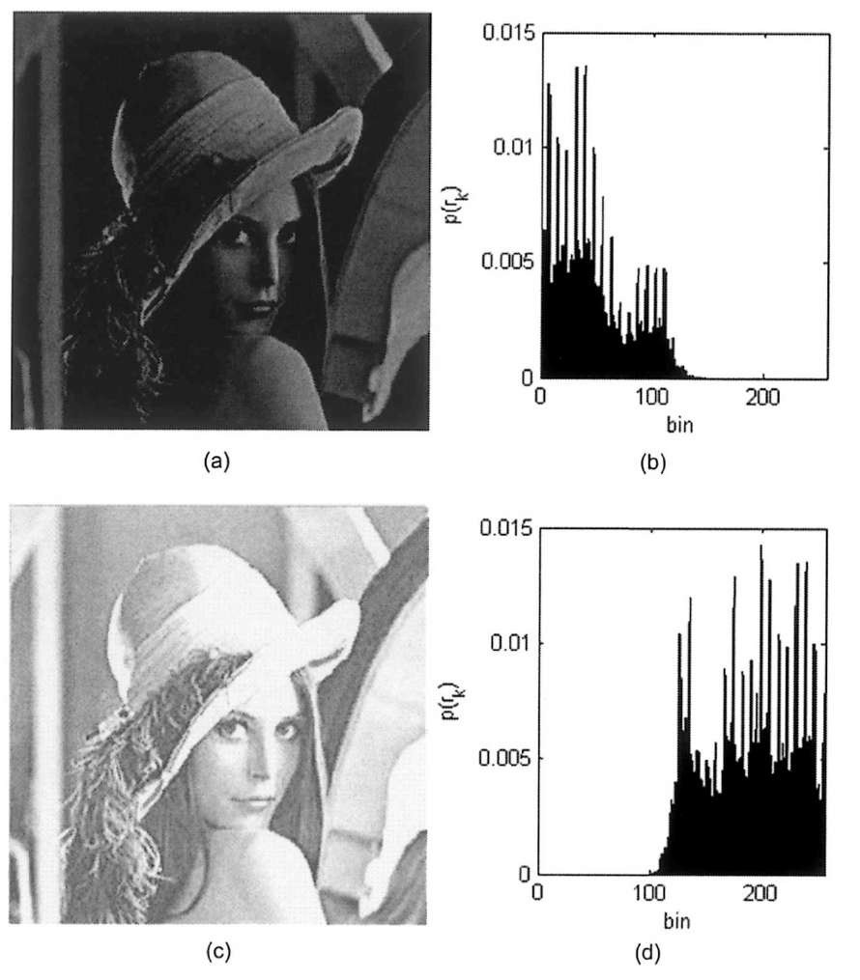
Widely Used DIP Methods
Histogram

Slide 6
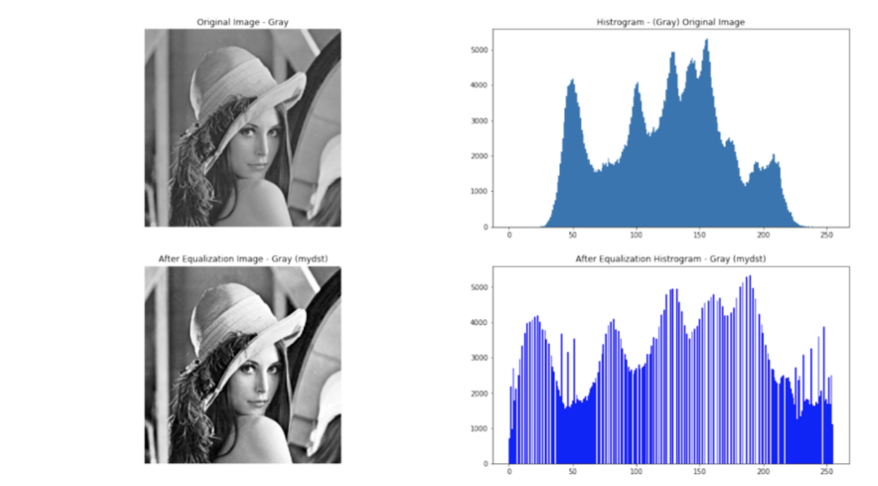
Widely Used DIP Methods
Histogram Equalization

Slide 7
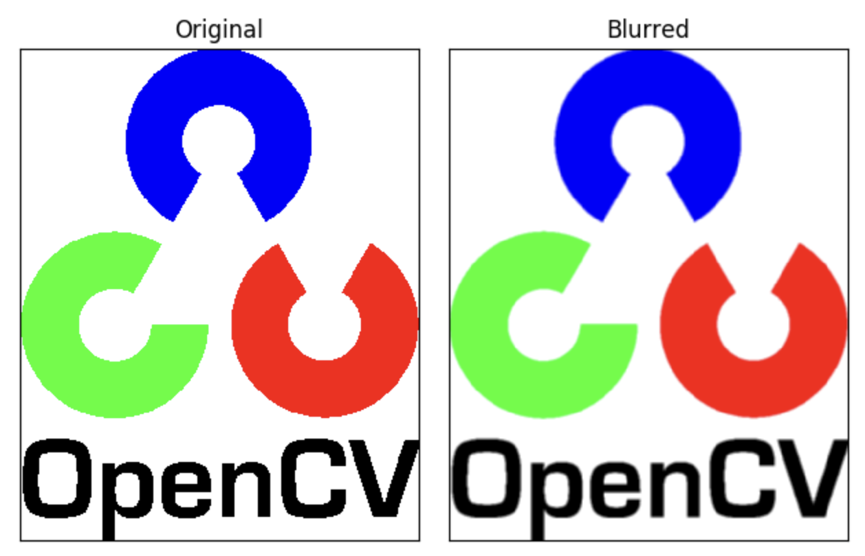
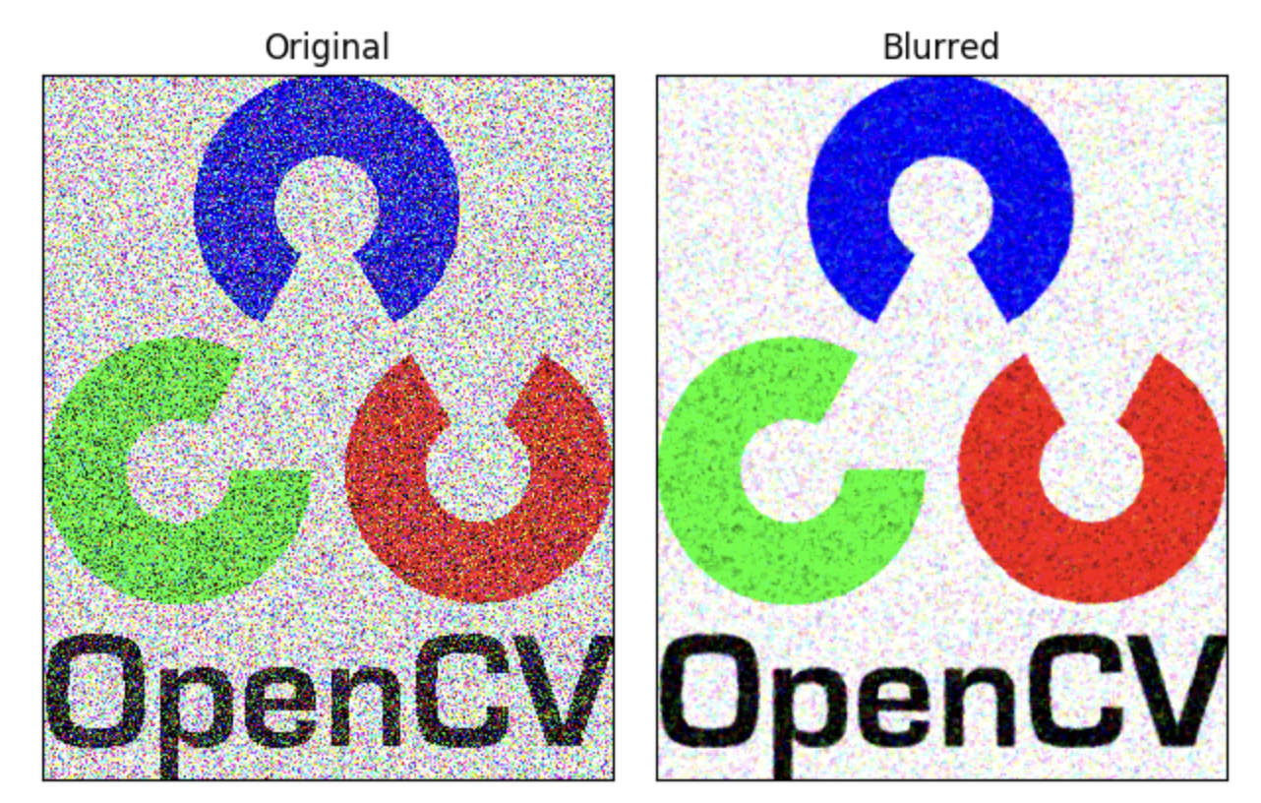
Widely Used DIP Methods
Blur:
mean blur
median blur
gaussian blur

Slide 8
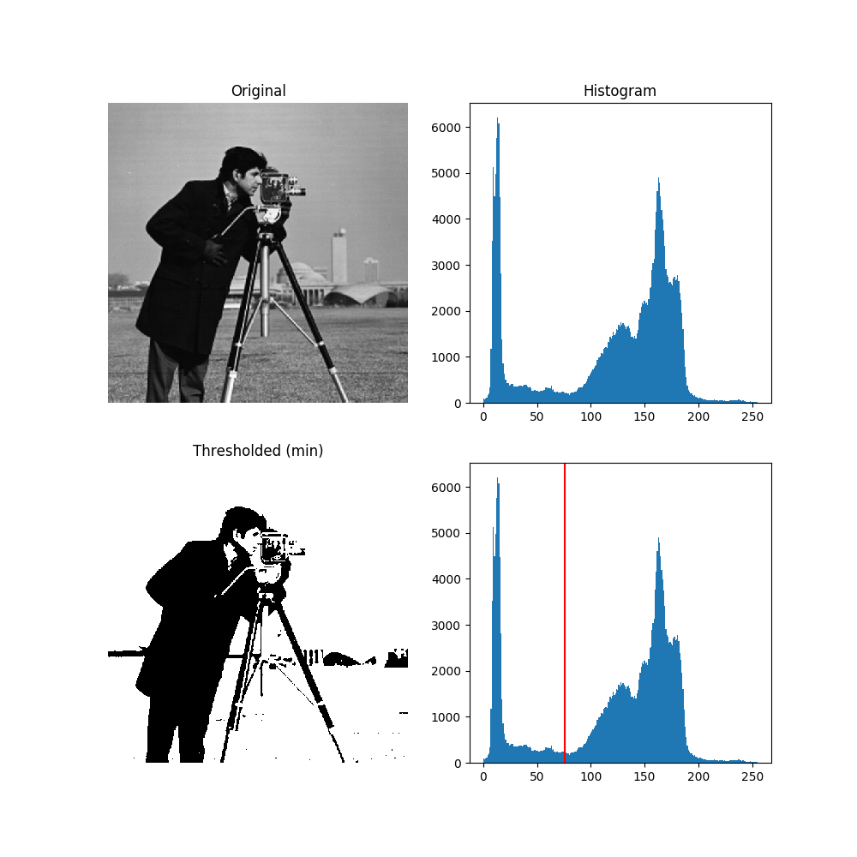
Widely Used DIP Methods
Binary

Slide 9
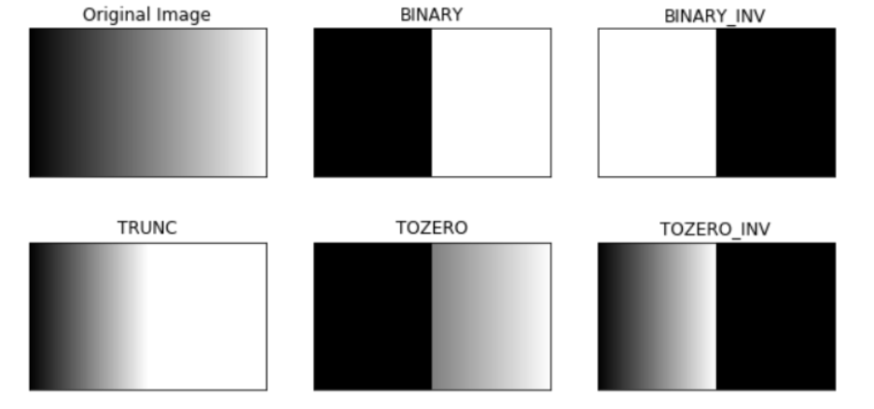
Widely Used DIP Methods
Binary

Slide 10
Widely Used DIP Methods
Binary

Slide 11
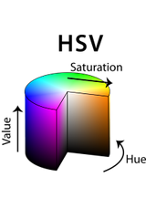
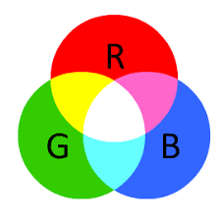
Widely Used DIP Methods
HSV filter

Slide 12
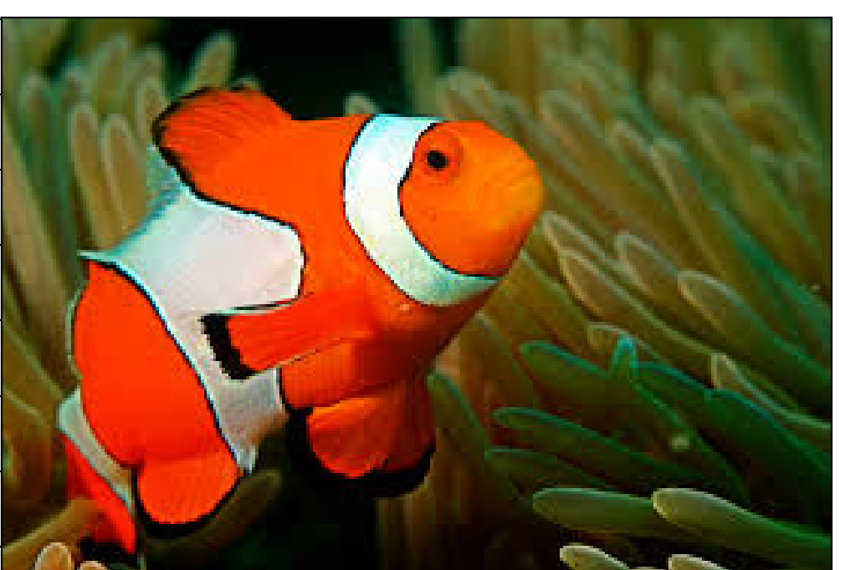
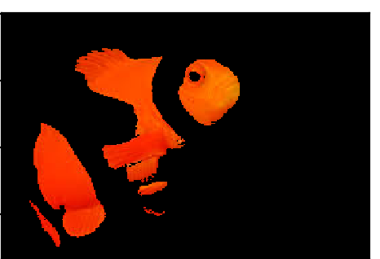
Widely Used DIP Methods
HSV filter

Slide 13
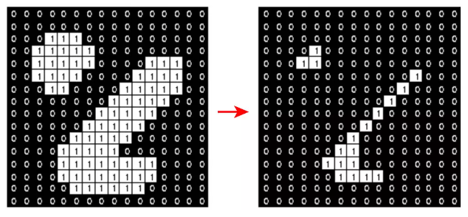
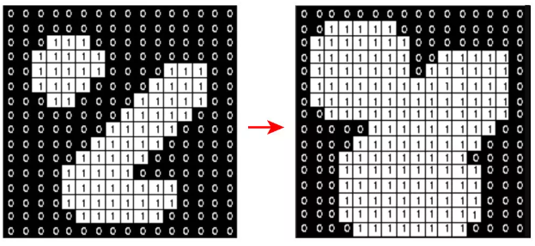
Widely Used DIP Methods
Morphological: erosion, dilation
Erosion
Dilation

Slide 14
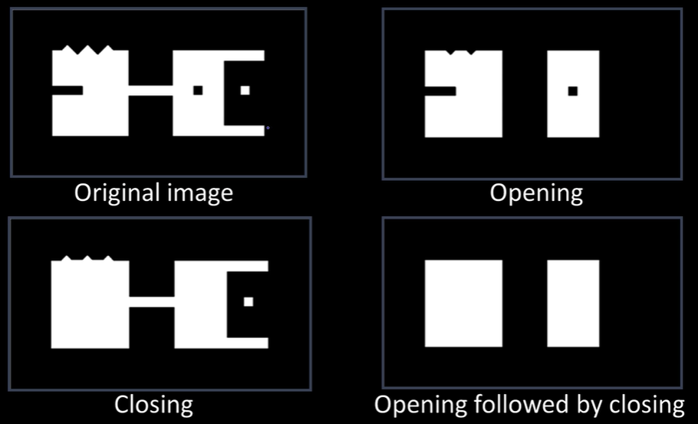
Widely Used DIP Methods
Morphological: open, close
Open
Close
erosion
Dilation
Dilation
erosion

Slide 15
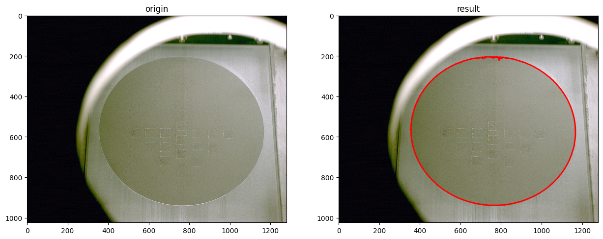
Widely Used DIP Methods
Find contours

Slide 16
Thanks for your attentions.
Enjoy your trip!

